Slide 1
Spatial econometrics with self-made weighting matrixes: uncovering similarity of sample with machine learning result and categorical variables.
Maria Mikos
mariamikos7@gmail.com

Slide 2
Linear regression
Spatial modeling
User-build matrixes
Testing the solution

Slide 3
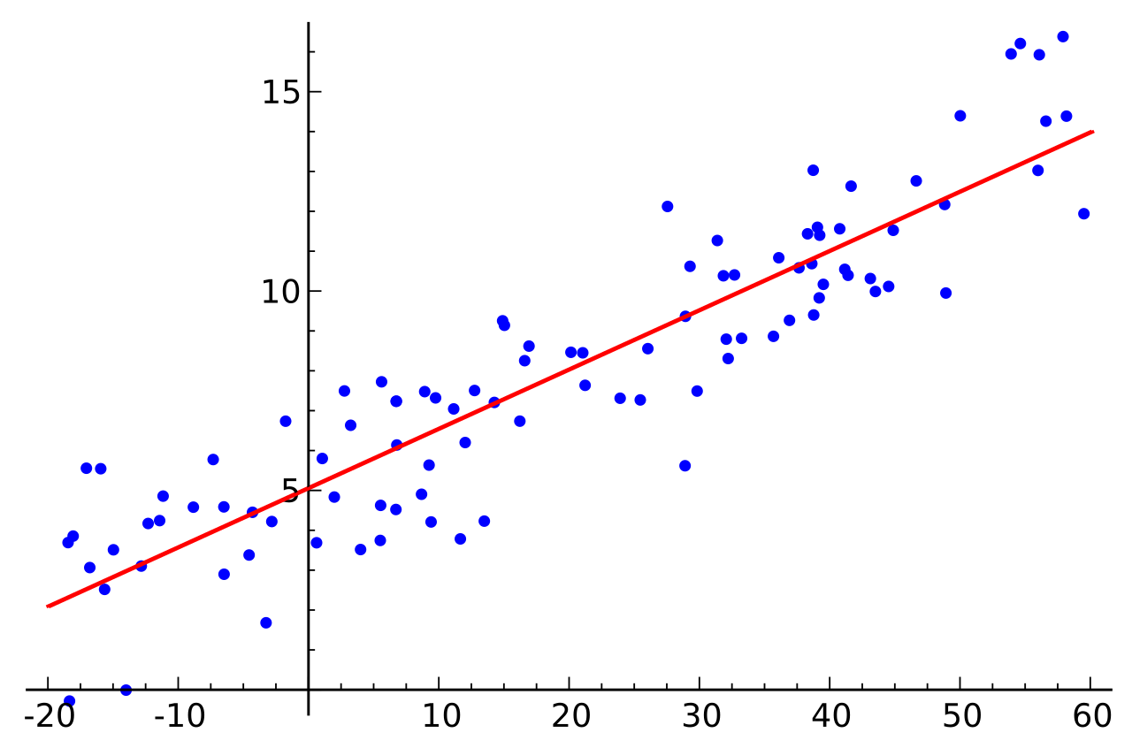

Linear regression
$$y=Xβ+ ε$$
$$y=β_{0}+β_{1}∗x_{1}+β_{2}∗x_{2}+…+ε$$

Slide 4

Categorical data
$$y=β_{0}+β_{1}∗cat+…+ε$$
$$y=β_{0}+β_{1}∗cat2+β_{2}∗cat3+…+ε$$
Item | Category | -> encode
Item1 | Cat2 | 2
Item2 | Cat1 | 1
Item3 | Cat2 | 2
Item4 | Cat3 | 3
Item5 | Cat1 | 1
Item | category1 | category2 | category3
Item1 | 0 | 1 | 0
Item2 | 1 | 0 | 0
Item3 | 0 | 1 | 0
Item4 | 0 | 0 | 1
Item5 | 1 | 0 | 0
Levels
Dummy variable

Slide 5

Spatial models
$$y=Xβ+ρWy+WXθ+u$$
$$u=ρW+ ε$$

Slide 6
Weighting matrix W
Contingency
Neighbors in distance d
K-nearest neighbors
…
 | Item1 | Item2 | Item3 | Item4 | Item5
Item1 | 0 | 1 | 1 | 0 | 0
Item2 | 1 | 0 | 1 | 0 | 0
Item3 | 1 | 1 | 0 | 1 | 1
Item4 | 0 | 0 | 1 | 0 | 0
Item5 | 0 | 0 | 1 | 0 | 0
2
5
1
3
4
spdep:: nb class

Slide 7

User-build matrixes
$$Treat groups as neighbours$$
$$Categories →W matrix$$
Item | Category | -> encode
Item1 | Cat2 | 2
Item2 | Cat1 | 1
Item3 | Cat2 | 2
Item4 | Cat3 | 3
Item5 | Cat1 | 1
 | Item1 | Item2 | Item3 | Item4 | Item5
Item1 | 0 | 0 | 1 | 0 | 0
Item2 | 0 | 0 | 0 | 0 | 1
Item3 | 1 | 0 | 0 | 0 | 0
Item4 | 0 | 0 | 0 | 0 | 0
Item5 | 0 | 1 | 0 | 0 | 0
spdep:: mat2nb()
base:: matix class
spdep:: nb class

Slide 8
Iris dataset
data("iris") names(iris)
## [1] "Sepal.Length" "Sepal.Width" ## [3] "Petal.Length" "Petal.Width" "Species"
levels(iris$Species)
## [1] "setosa" "versicolor" "virginica"
#only numerical variables
mod1<-lm(Sepal.Length~Sepal.Width+Petal.Length+Petal.Width, data=iris)
#with categorical variable mod1a<-lm(Sepal.Length~Sepal.Width+Petal.Length+Petal.Width+Species, data=iris)

Slide 9

Iris dataset W matrix approach
matt<-matrix(0, nrow=150, ncol=150)
c1<-which(iris$Species=="setosa") #repeat for each category
for(i in 1:(length(c1)-1)){ for(j in (i+1):(length(c1))){ matt[c1[i],c1[j]]<-1 matt[c1[j],c1[i]]<-1 } } #repeat for each category
for(i in 1:150){ #row-standarizing c<-sum(matt[i,]) for(j in 1:150){ matt[i,j]<-matt[i,j]/c } } sim.listw<-spdep::mat2listw(matt)
$$y=Xβ+u$$
$$u=ρW+ ε$$
library(spdep)
mod2<- errorsarlm(Sepal.Length ~ Sepal.Width+Petal.Length+Petal.Width, data=iris, sim.listw, tol.solve=2e-40)
Building a W matrix – Species are neighbours

Slide 10
Iris – comparison
## AIC BIC ## linear 84.64272 99.69590 ## linear with levels 79.11602 100.19047 ## W matrix in error term -21.97994 -3.91613

Slide 11
GUS dataset
colnames(poviatdata)
## [1] "ID_MAP" "Code" "Name" ## [4] "births" "marriages" "fhigher" ## [7] "fdependant" "munempl"
Dataset
2011 Poviat data (NUTS4)
Geocoded variables
Basic linear model:
Dependent variable: births - number of births in a poviat
Independent variables (Becker’s theory):
marriages - Number of marriages
fhigher - Women with higher education per 1000 women in a poviat
fdependant - Percentage of dependant women in a poviat
menunempl - Unemployment index for men in a poviat
modelBase<-lm(births ~ marriages + fhigher + fdependant + menunempl, data=poviatdata)

Slide 12


GUS dataset – other matrixes and models
$$y=Xβ+u$$
$$u=ρW+ ε$$
$$y=Xβ+ρWy+ ε$$
2a) Spatial lagging the dependent variable
matrixW -> spatial neighbourhood (contingency matrix)
2b) Lagging the dependent variable with groups
matrixW -> 3 groups for dependent variable – neighours have simmiliar values for births
Lag in error
matrixW – clustering result for independent variables (kmeans, k=2)
model1<-errorsarlm(births ~ marriages + fhigher + fdependant + menunempl, data=poviatdata, matrixW, tol.solve=2e-40)
model2<-lagsarlm(births ~ marriages + fhigher + fdependant + menunempl, data = poviatdata, matrixW, method="eigen", quiet=FALSE)

Slide 13
GUS dataset - comparison
## AIC BIC ## modelBase 951.5496 975.1906 #linear ## model1 947.1243 974.7055 #clust in error ## model2a 817.7146 845.2958 #spatial lag ## model2b 413.3107 440.8919 #births groups lagged

Slide 14
Conclusion
spdep::mat2nb() allows to build own W matrixes
Numerous combinations for spatial-like models
Encode categorical variable and groups in dataset in a W matrix
Possibility to improve econometrical estimation
Omit the overbias
Better fit of the model

Slide 15
Thank you!

